Slide 1

Location Detection Product: Technical, Legal, Ethical, and Business Challenges
CSC 859, Fall 2022
Theodore McCullough
Ishank Aggarwal
Alex Rabanes

Slide 2


Location Detection Product Overview
Kitchen
(1)
Bedroom
(2)
Bathroom
(3)
RF-ML Model
Living Room
(4)
Location Predictions

Slide 3
RF-ML Model: Performance Comparison
High
Accuracy
100
100%
95.16%
83.28%
92.68%
90.47%
80
77.53%
High
Confidence?
64.66%
60
40
20
0
PSO-NN
GSA-NN
PSOGSA-NN
FPSOGSA-NN
SVM
NAÏVE BAYES
RF-ML

Slide 4
Technical Challenges: Wireless Indoor Localization Data Set
Access Point 1 | Access Point 2 | Access Point 3 | Access Point 4 | Access Point 5 | Access Point 6 | Access Point 7 | Class
-64 | -56 | -61 | -66 | -71 | -82 | -81 | 1
2000 samples total
Seven (7) features per sample, each feature representing the signal strength of a Wi-Fi access point appearing on a mobile device
Four (4) possible classes (1, 2, 3, 4) for each sample, the classes corresponding to one of four (4) rooms in a structure
Each class representing twenty-five percent (25%) of sample total
No missing data

Slide 5
Technical Challenges: Problem Set Up RF-ML Model
1000 Tree RF-ML Forest
1600 Training Instances, 400 Test Instances
6 Features Examined at each Split
.5 Cut Off Value
Sci-Kit Learn & Jupyter Notebook IDE

Slide 6
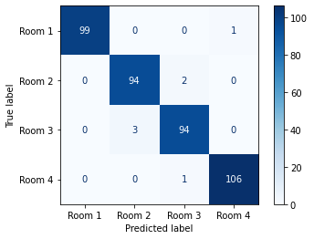
Technical Challenges: Confidence Metrics for RF-ML Model
Suggests High Confidence
Recall- 1.0
Precision- 1.0
F1 Score- 1.0
OOB Accuracy- .98

Slide 7
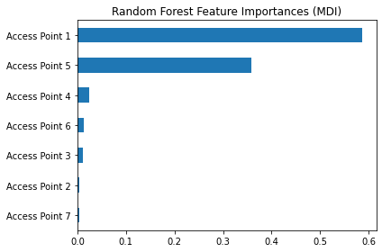
Technical Challenges: Confidence Metrics for Top Features for RF-ML Model
Suggests High Confidence
Together Access Point 1, 5, & 4 Constitute 94% of features used to make a prediction
Metrics for Top 3
Precision .99
Recall .98
F1 Score .98
OOB Accuracy .98
Cohen values >.8

Slide 8
Legal Challenges: EU’s General Data Protection Regulation (GDPR) and Artificial Intelligence Act (AIA)
GDPR
Personal Data
Legal Processing (e.g., Consent, Contractual Necessity)
Technical and Organizational Measure to Protect Data
AIA
Explainability, Transparency and Data Provenance By Design

Slide 9
Legal Challenges: Audit Plan
Product Life Cycle- Creating and maintaining a risk management system for the entire life cycle of the RF-ML Product
Conception-
Designed with sufficient transparency to allow users to interpret the system’s output
Designed to maintain human oversight at all times and prevent or minimize risks to health and safety or fundamental rights, including an override or off-switch capability
Production-
Testing the system to identify risks and determine appropriate mitigation measures, and to validate that the system runs consistently for the intended purpose, with tests made against prior metrics and validated against probabilistic thresholds
Establishing appropriate data governance controls, including the requirement that all training, validation, and testing datasets be complete, error-free, and representative
Detailed technical documentation, including around system architecture, algorithmic design, and model specifications
Market-
Automatic logging of events while the system is running, with the recording conforming to recognized standards

Slide 10

Ethical Challenges: “One’s Home is Their Sanctuary”
Trust: RF-ML Product Should Not Intrude on this Sanctuary
Prove→ “Why trust us with your location data?”
Marketing and Execution…

Slide 11
Business Challenges: Investment
Explainability, Transparency and Data Provenance By Design
Product Life Cycle- Internal Management System
Production- Extended Beta Periods
Market- Wireless Connectively
Explainability
Transparency
Data Provenance

